Slide 1
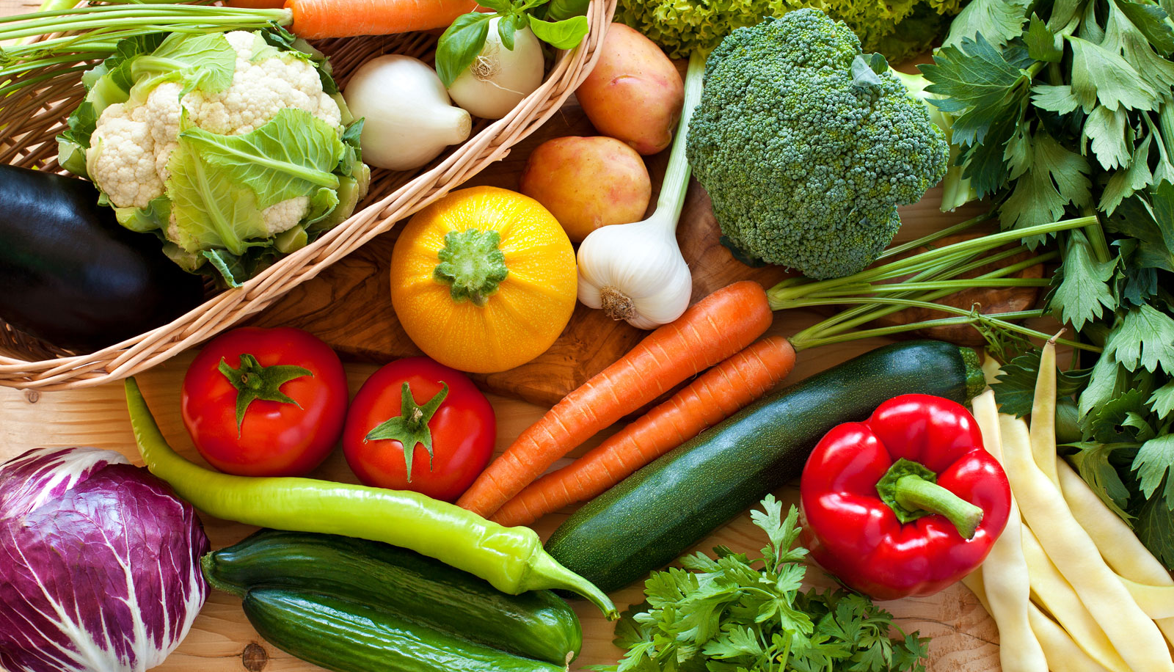
2025 Dahlonega Farmers Market
May 3rd, 2025

Slide 2
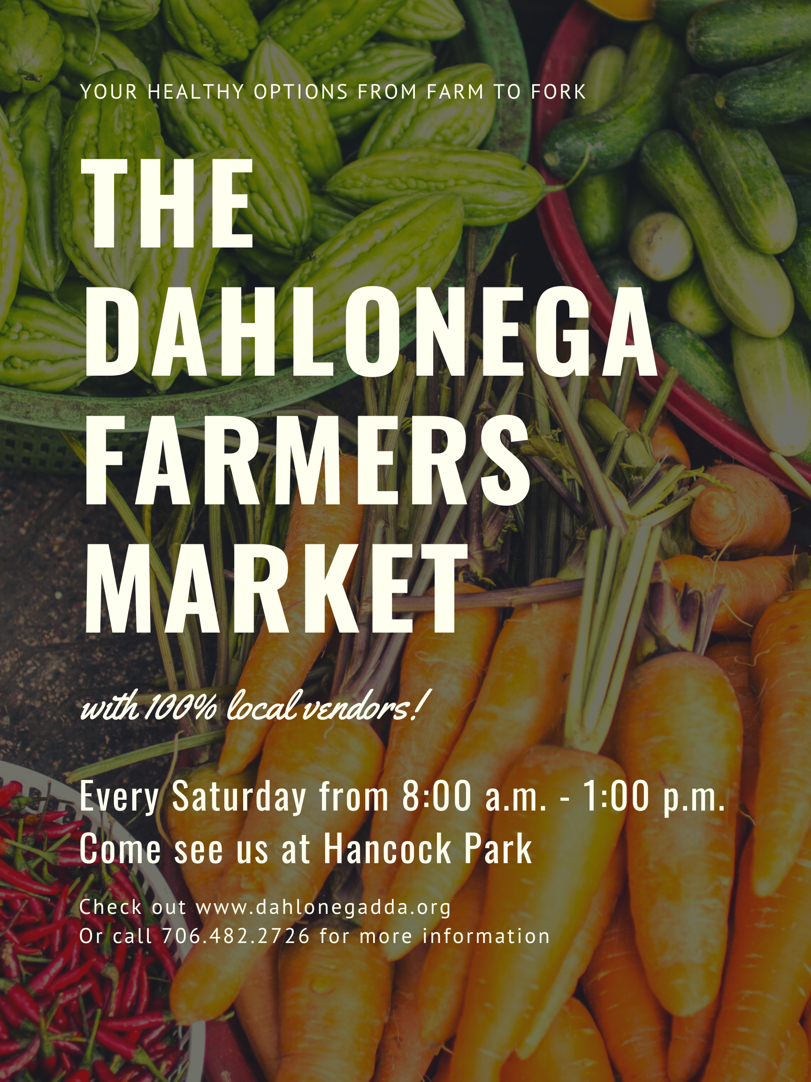
2025 Market Details
Season Begins Saturday, May 3rd
Season Ends Saturday, October 11th
Times:
Saturday’s 8:00 a.m. – 1:00 p.m.
Location: Public Parking Lot, Located Adjacent from Hancock Park
Cost to Vend: $10/Month or $50/Full Season

Slide 3
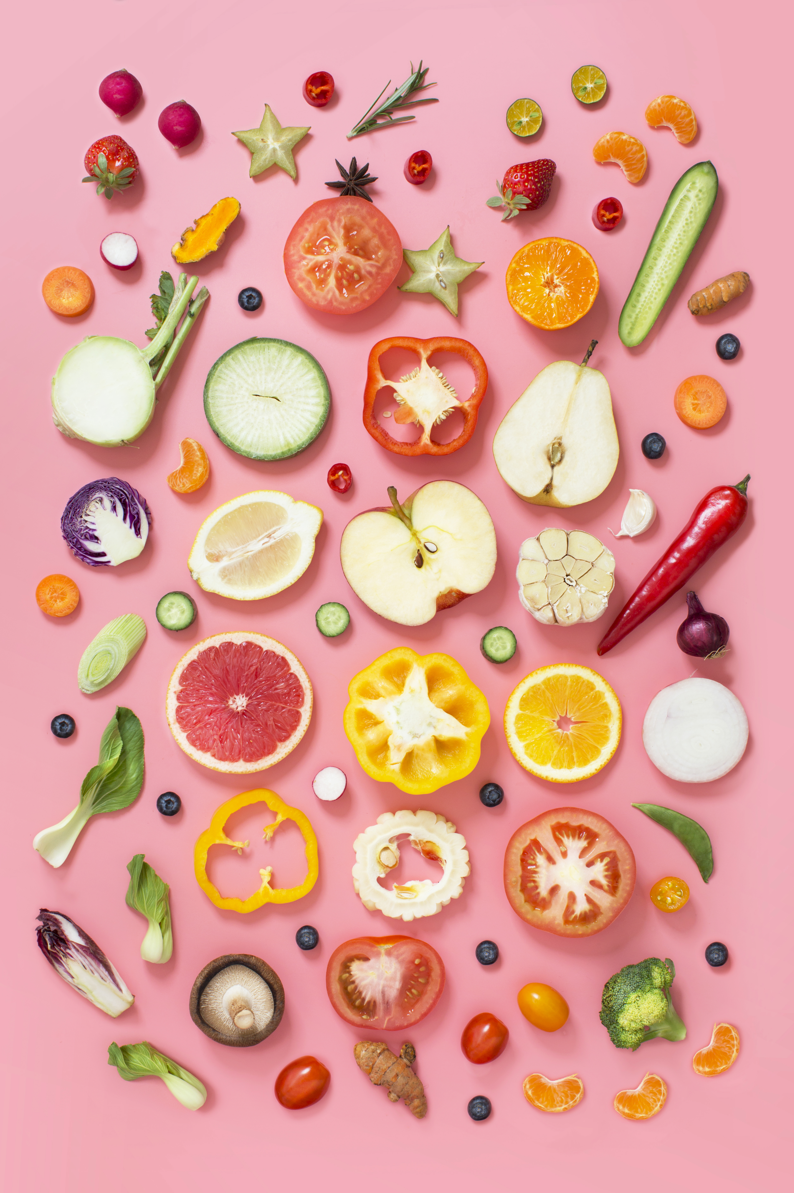
Market Details Cont.
No selling prior to official opening time
Annual Permit Fee: $50
Monthly Permit Fee: $10
10 x 10 space – tents will not be provided
May sell from trucks for special purposes

Slide 4
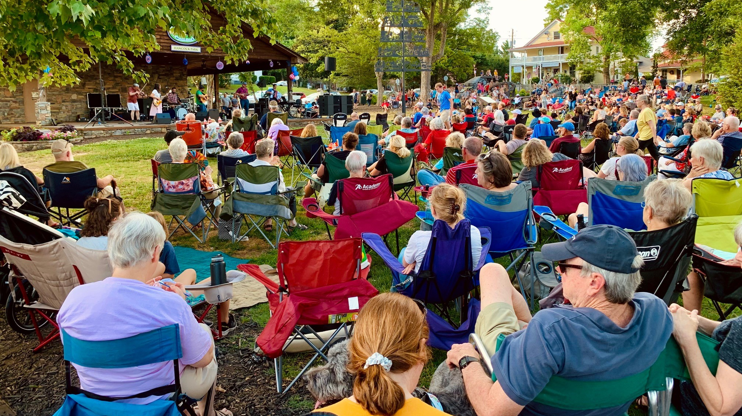
New Additions to the market
Local Music – when available
No assigned spots, you will still receive a vendor number, but there will be no spot number assigned to you – the spots will be first come, first serve. Please do not leave gaps in the market space, try to line up
Location: This new location means the market will not occur once during the Arts & Wine Festival. This location is easier to shut down and causes fewer traffic issues
We have assigned a marketing manager for the Dahlonega Farmers Market Facebook page. That marketing manager is a DFM vendor
Please let me know if you will not be in attendance for one or more market days. The vendor list exceeded capacity last year, so if you will not be there, please let me fill the spot from a waitlist vendor

Slide 5

What can you sell?
Agricultural Items
Jams & Jellies – requires cottage food license
Package foods (consumption or use) containing at least one product the vendor has grown, proper labeling & state license from the GDA
  All processed products should be labeled with:
    The common name of the food
    The name, address, contact info of the person who made the item
    A list of all the (common name) ingredients within the item
Eggs, dairy products or meat with proper state license from the GDA

Slide 6
Market promotions
Signage throughout DT (A-Frames)
Local listing on Chamber of Commerce Calendar
The Dahlonega Nugget Ads
Social media and website posts
Local listing on Dahlonega Downtown Calendar
Farmers Market posters posted around the city

Slide 7
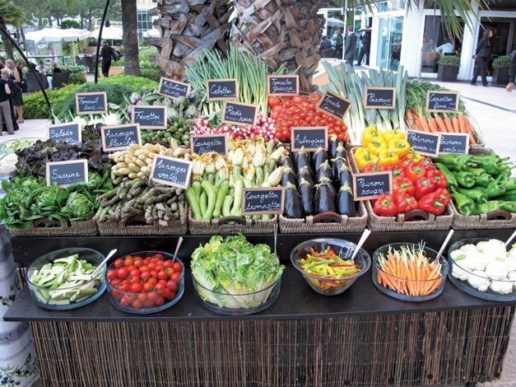
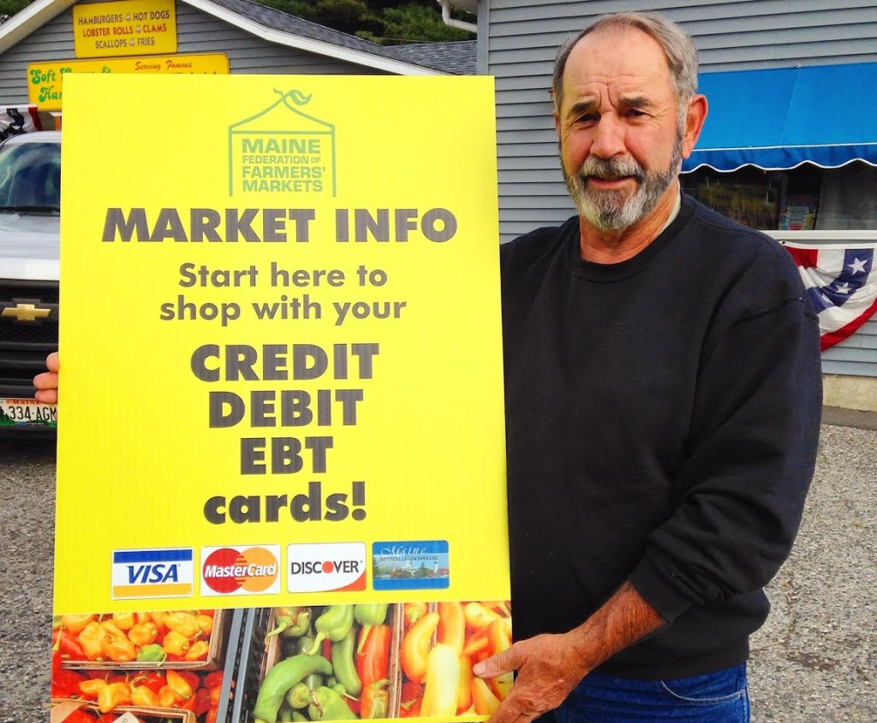
Helpful tips
The more information the better – prices are the bare minimum
Examples
Payment Methods
Descriptions
Clear Signage
Recipes

Slide 8
Signage is invaluable
Go Beyond the basics:
  Include weight
  Cooking instructions
  Meal Plans
  Anything that may be useful or just fun facts
Customers love signs & explanations
  Label everything with a name and price
  Food w/o prices doesn’t sell well – shy people
Don’t limit your signs to prices- you have much to say
Description for your farm – brag about your work
ORGANIC
Recipes are critical – teach your customers how to use your products and give meal ideas

Slide 9
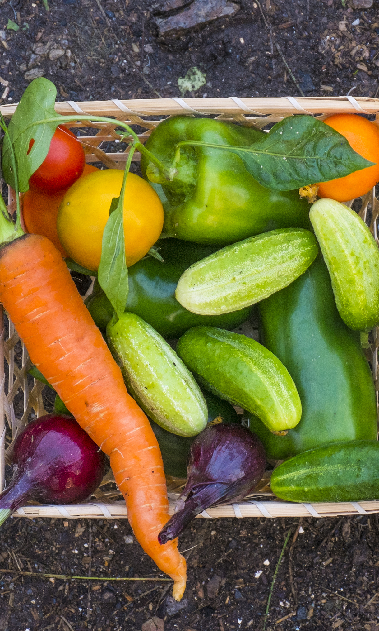
Quality and presentation
You must restock constantly
REMEMBER – The “Smallest Container Rule”
  The produce you have should always be in the smallest container in which it fits
If you start out with a crate of apples, keep it full throughout the whole market. If you only have half a crate left, find a smaller crate or basket
For example, by the end of the market, you should only have a few bell peppers in a quart box or squash in a gallon basket.
  Customers dislike buying the last of anything – it looks like no one wanted that one
Remember – smaller containers project the appearance of abundance

Slide 10
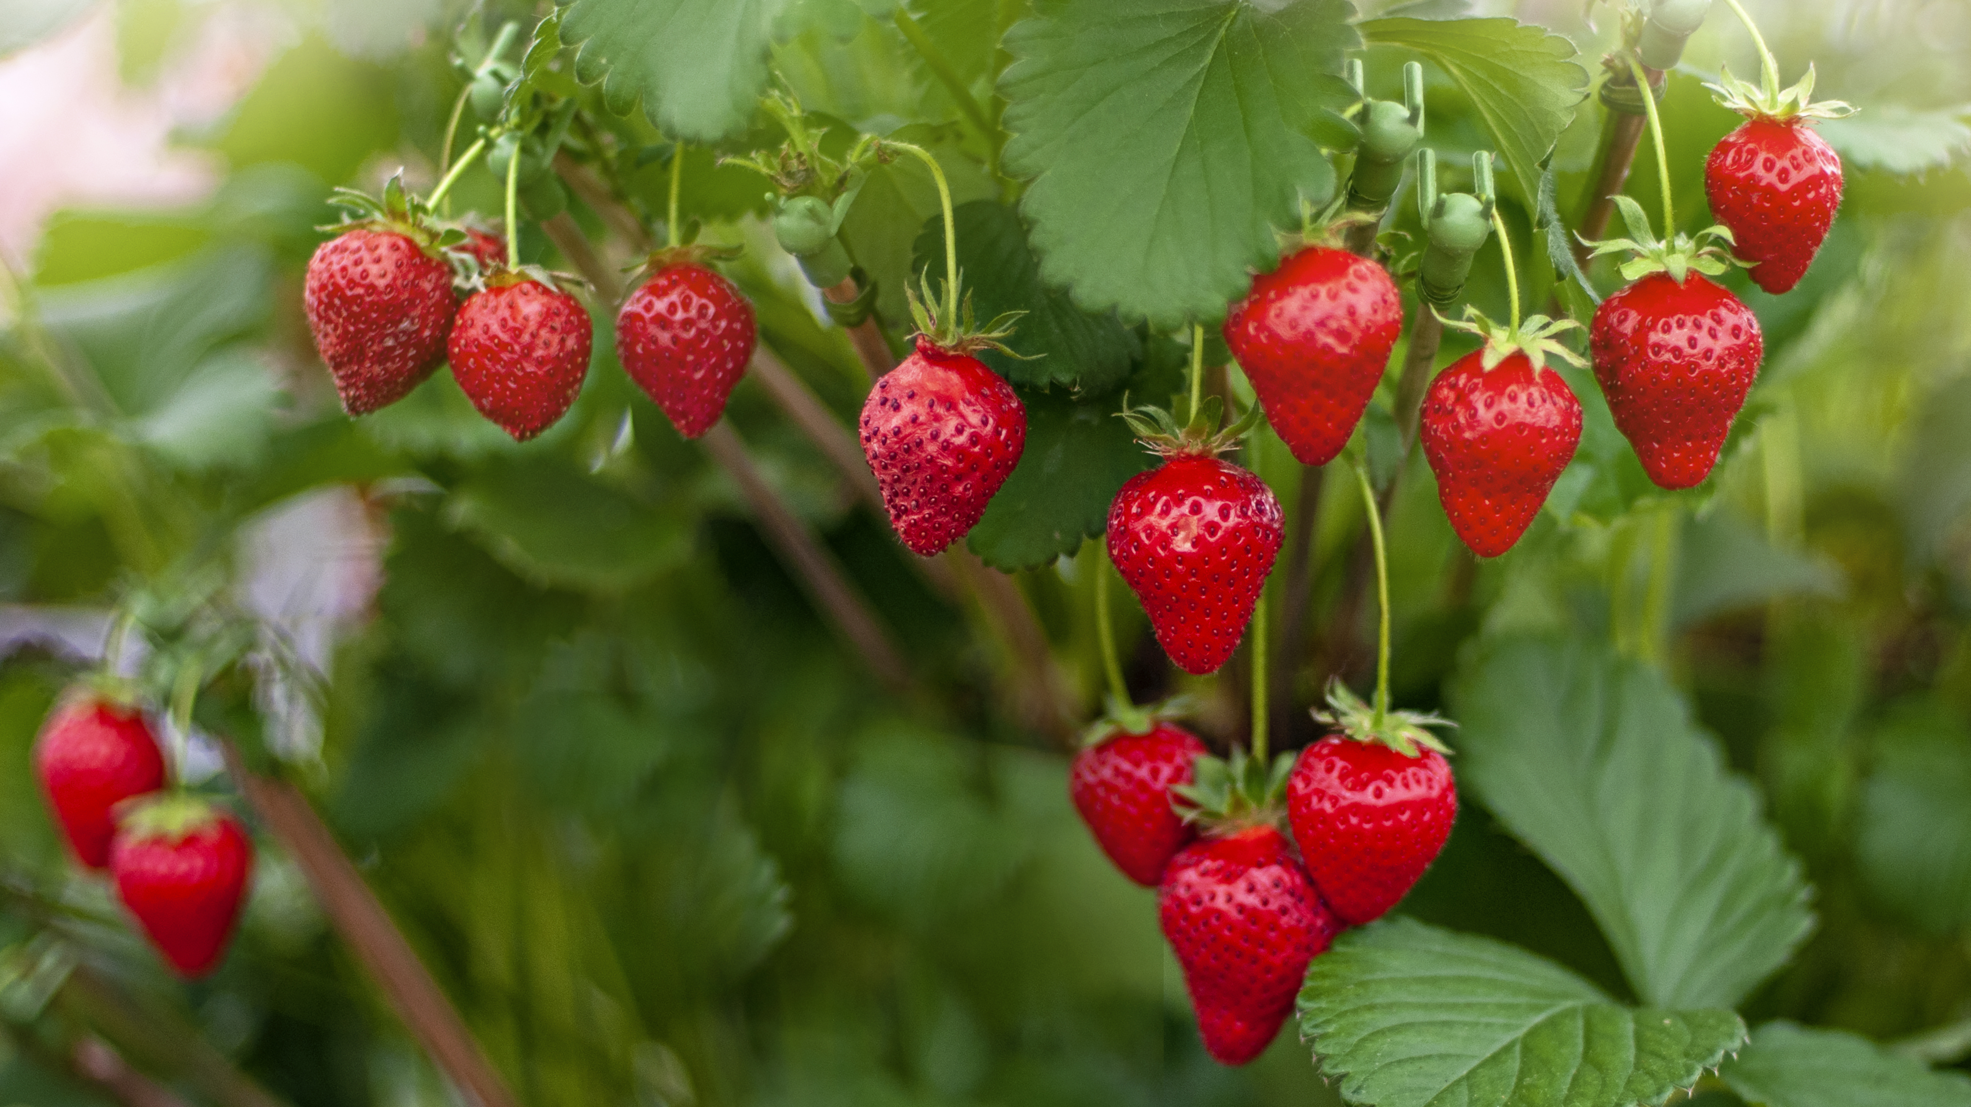
Quality products
Offer something bigger & better than supermarkets
  The SWEETEST strawberries
  Handmade bread
  Pastry w/ real butter
  Raw honey
  Fresh eggs
  For processed foods, use GOOD ingredients and tell the story - it’s handmade, cured properly, and not treated with chemicals
  Rarity itself can be a virtue. Grow traditional and unusual varieties and breeds

Slide 11
Provide Samples
People love testing out the product before purchasing. This also gives you an education opportunity.
Sample different varieties of products and let the customer pick their favorite(s)

Slide 12
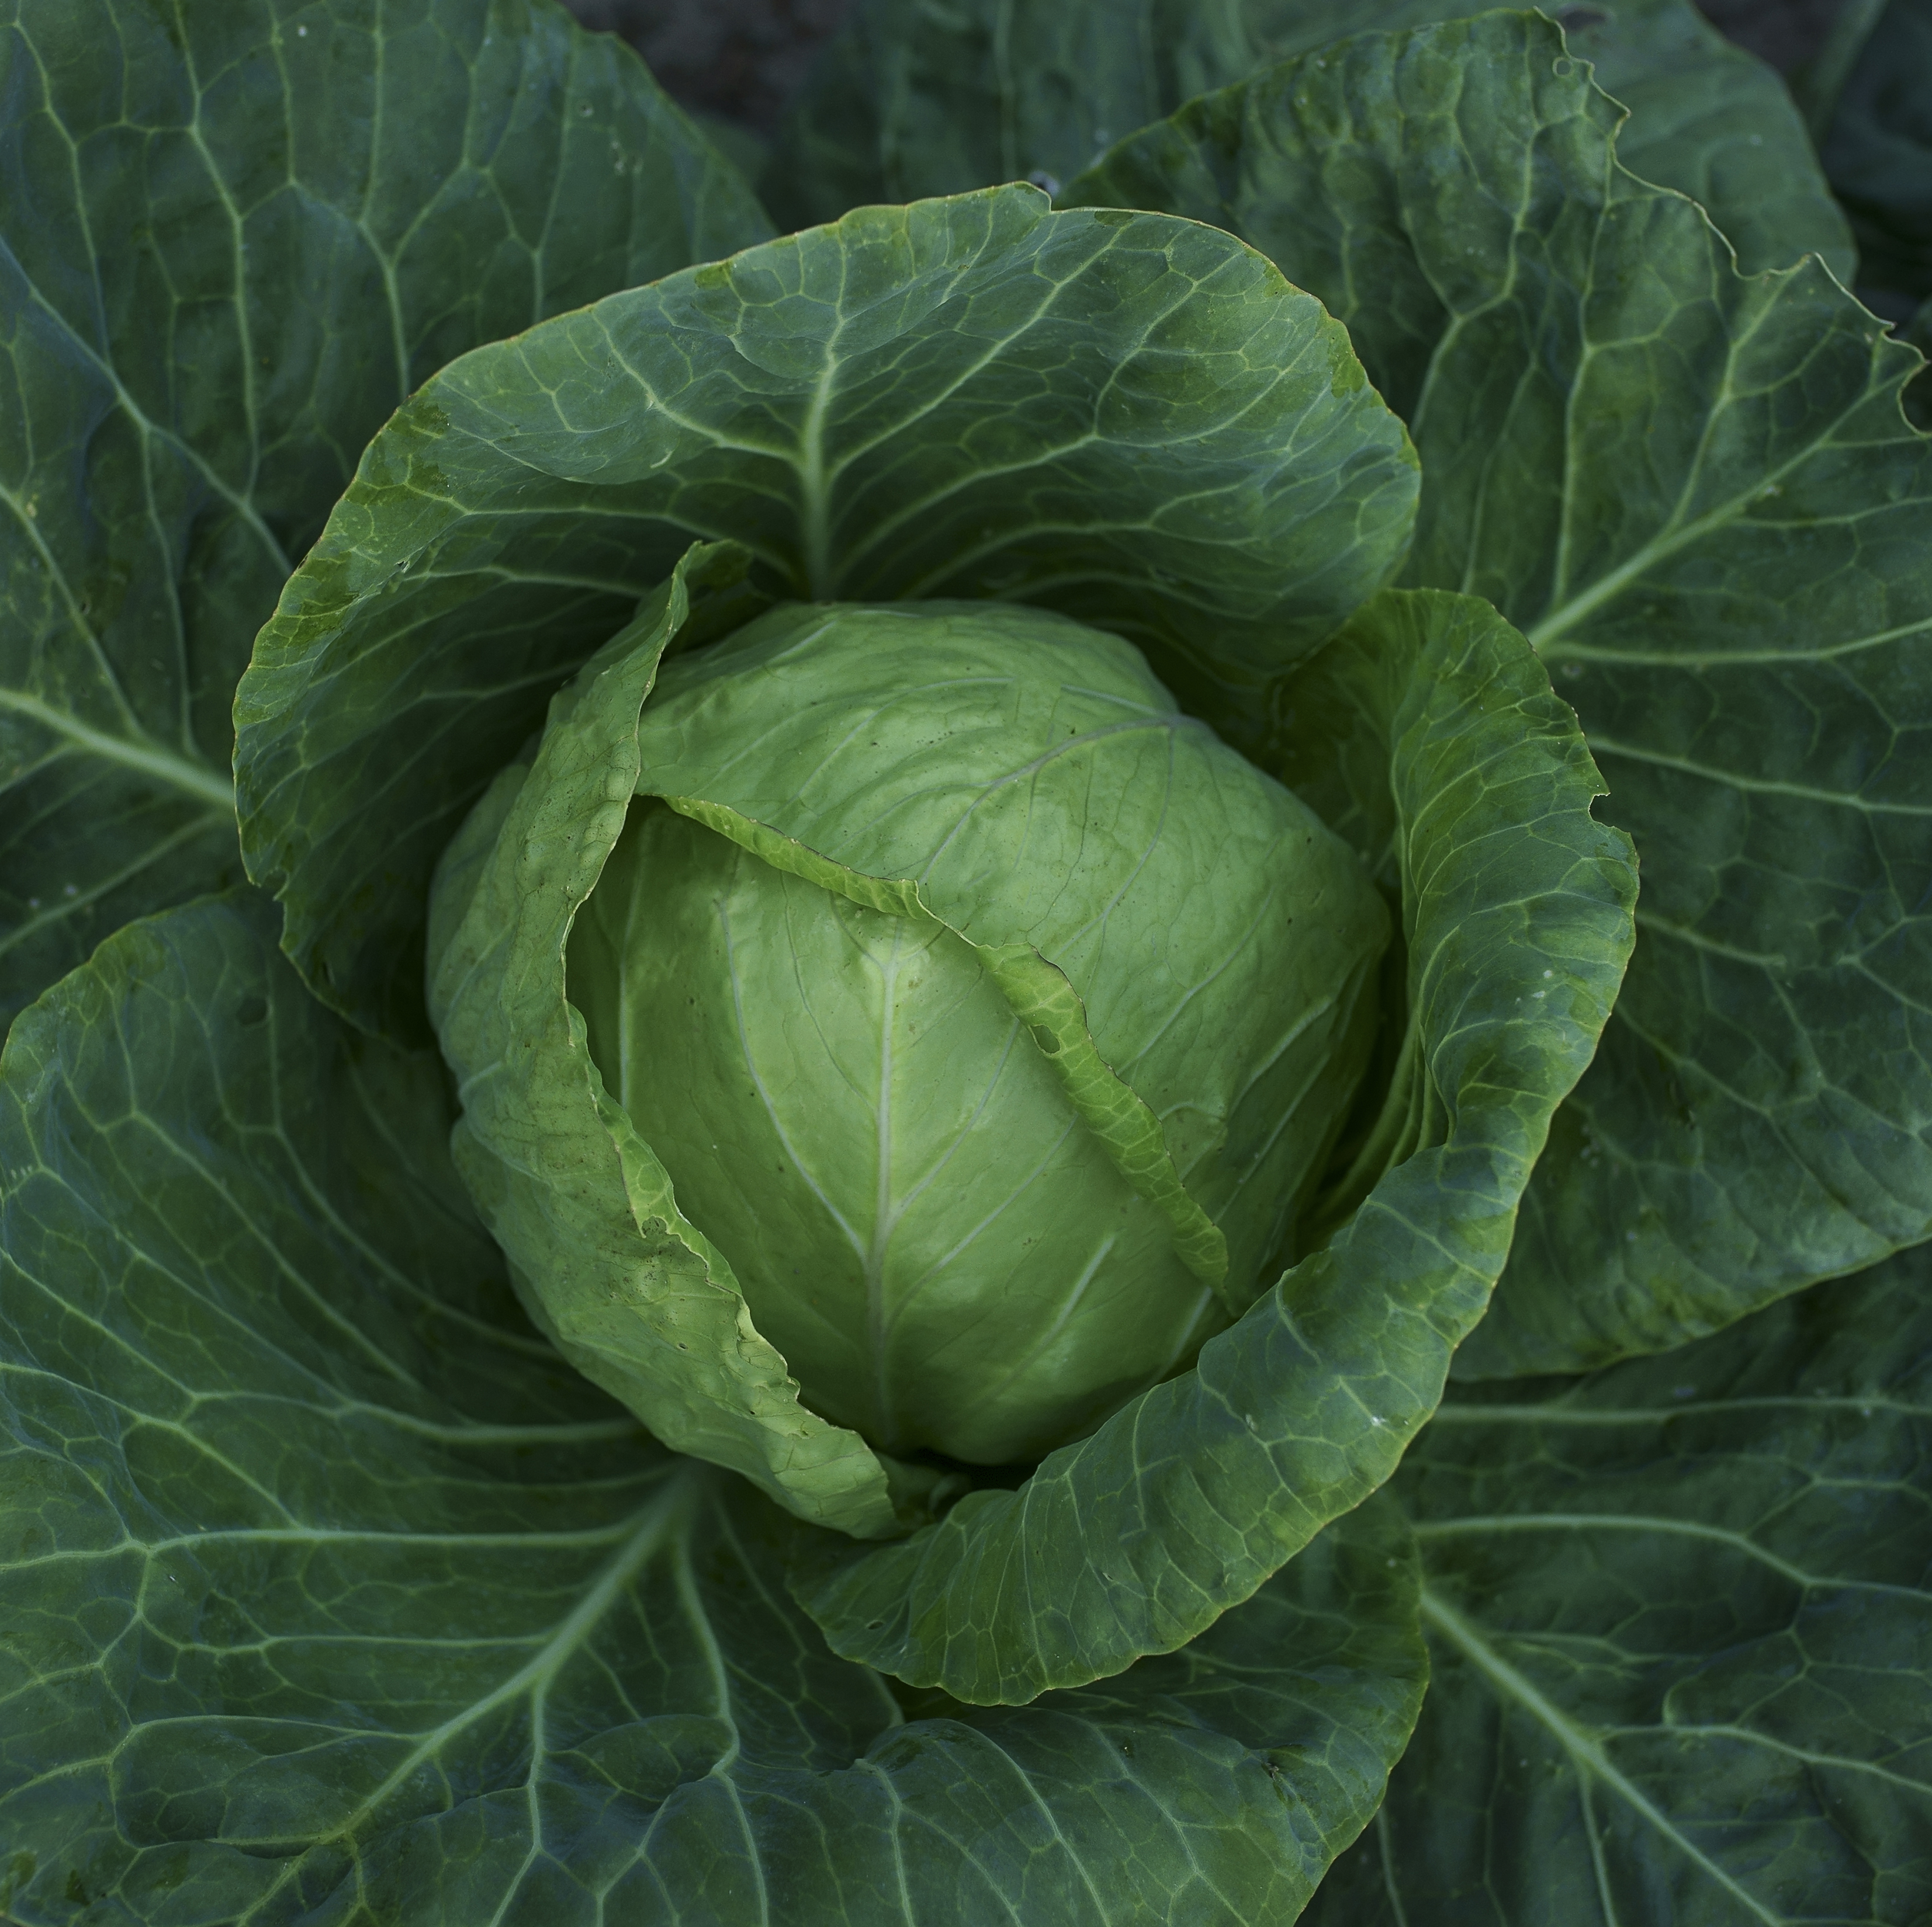
Go the extra mile
No one likes spending money on good food just to have it go to waste
If you tell customers how to keep what they buy fresher for longer, they wont worry about buying too much
For example, make cards or signs that say:
HOW TO KEEP LETTUCE:
Wash, spin, dry, & wrap in a damp kitchen towel in the fridge for several days

Slide 13
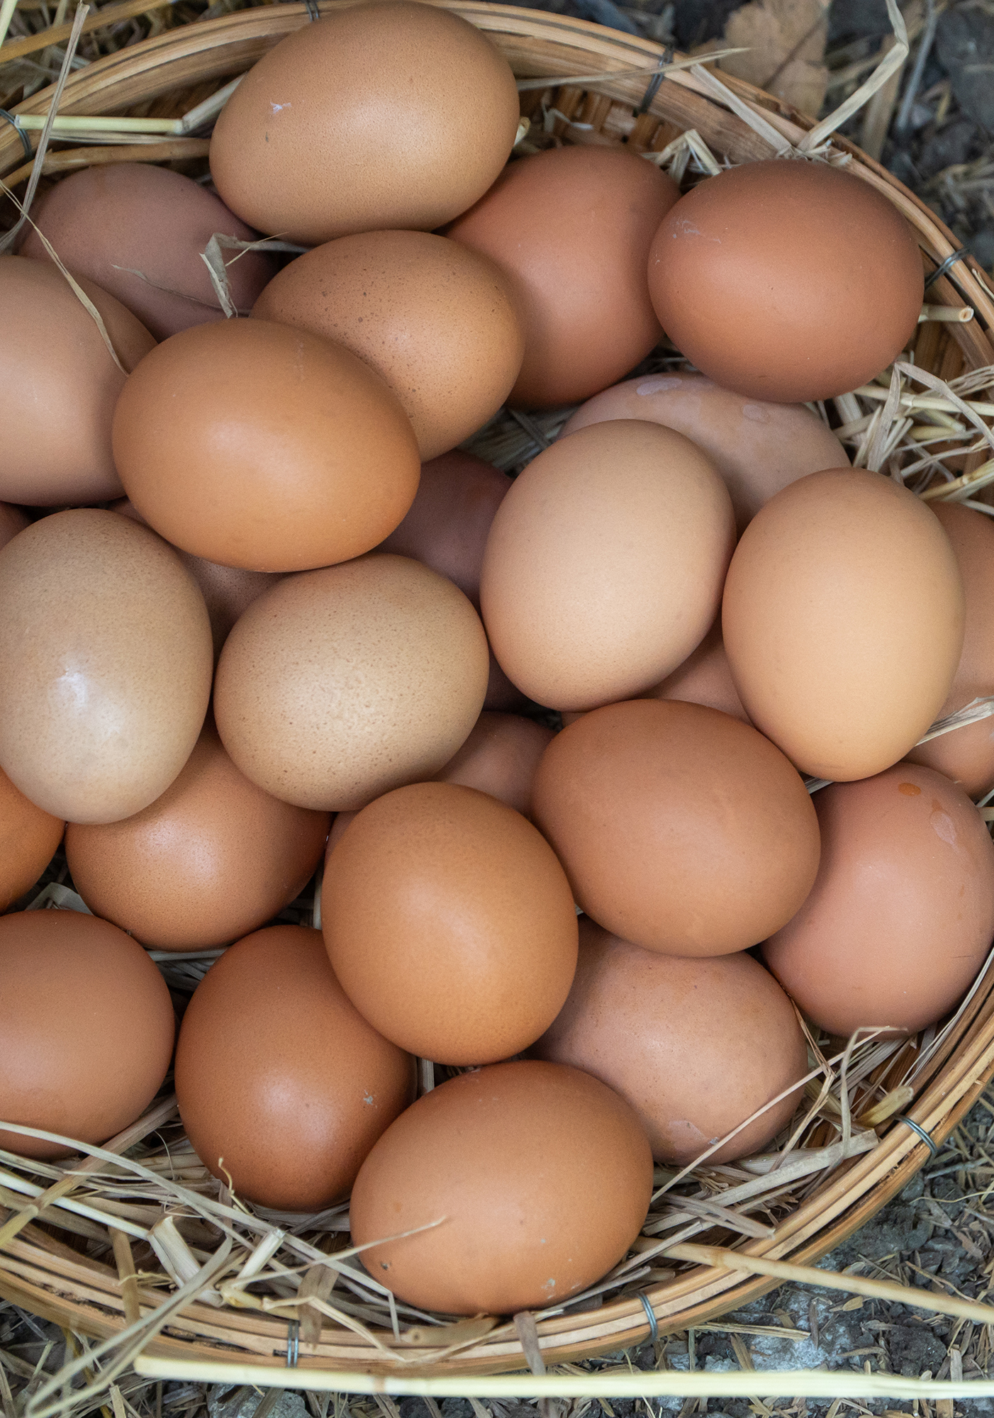
Participate the whole season
Good for the grower and the market as a whole – more vendors means more customers
Especially true for fruit and veggie farmers
To make a good return form the market, you need to have Spring, Summer, & Autumn crops
It is less expensive to participate the whole season rather than paying monthly.

Slide 14

Share your story
More than your food, part of the Farmers Market experience for customers is meeting the farmer and learning about their farm
  Pictures of crops, animals, processes (making bread, cheese, etc..) are charming and interesting to non-farmers and they bring your booth to life
  Pictures also reinforce the message that we are all linked to farmland through food

Slide 15
Attitude is everything
Be enthusiastic & friendly
Be personable, talk about your farm, show your love for your products
Move around your stand
Walk to the front of your stand every so often, for the customers view
Pick up trash (even if it is not yours)
Portray your opinion of your products
You must give customers a reason to buy
Avoid sarcasm, indifference, SMOKING, music, and the impression ”I just work here”
DO NOT SMOKE
Against DFM permit and potentially offensive to customers

Slide 16

Remember
“People still have money in their pocket when they are leaving, give them every opportunity to spend that money at your stand”

Slide 17
Q & a Time
Skyler Alexander – Main Street Manager, 706.974.8152, salexander@dahlonegadda.org
If you have a problem or suggestion, reach out to someone on our team and we will be happy to help
Our team serves and markets your business to the public.

